Slide 1

Introduction to Bootstrap

Slide 2
Agenda
HTML vs CSS vs JavaScript
Responsive Web Design
Bootstrap

Slide 3
HTML vs CSS vs JavaScript
HTML controls structure of pages
CSS controls style of pages
JavaScript makes page alive

Slide 4
HTML vs CSS vs JavaScript
HTML5
Markup language for the structure and presentation of world wide web contents
5th major version of HTML
Support the traditional HTML and XHTML
Also cross-platform (tablet, smartphone, notebook or smart TV)

Slide 5
HTML vs CSS vs JavaScript
CSS3
Presentation language to give content style and appearance
Style rules for HTML documents
The latest standard for CSS
Completely backwards-compatible with earlier versions of CSS

Slide 6
Responsive Web Design
A website that renders the content respond to the device that accesses it
Makes web page look good on all devices
Uses only HTML and CSS
Is not a program or a JavaScript

Slide 7

Responsive Web Design
4 Main Point
HTML5
CSS3
Media Queries
Design
Notes:
Design from smallest to larger viewport/screen size
Stop thinking in pages, start thinking in systems

Slide 8
Responsive Web Design
Viewport
The viewport is the user’s visible area of a web page
The viewport varies with the devices

Slide 9
Responsive Web Design
Viewport
Setting by the <meta> tag
width can be specified in pixels; the value device-width detects the width of whatever device the user is using
initial-scale=1.0 means no zooming will be applied
Not recommended: Adding maximum-scale=1 means the users cannot zoom (this may be bad for some content)
<meta name="viewport" content="width=device-width, initial-scale=1.0">

Slide 10
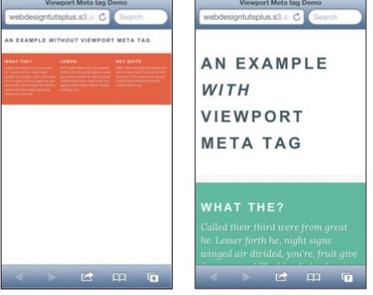
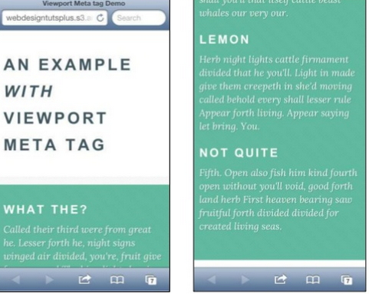
Responsive Web Design
Viewport

Slide 11
Responsive Web Design
Media Queries
A media query combines a media type and a condition to specify how web content will appear on a particular receiving device
Media query are a part of CSS3 and they are what make responsive web design possible
Media query can be used to check
width and height of the viewport
width and height of the device
orientation – is the tablet/phone in landscape or portrait mode
resolution

Slide 12
Responsive Web Design
Media Query Syntax
@media not|only mediatype and (expressions) { css-code; }
<link rel="stylesheet" media="mediatype and|not|only (expressions)" href="media.css">
Media Types
Value | Description
all | Used for all media type devices
print | Used for printers
screen | Used for computer screens, tablets, smart-phones etc.
speech | Used for screen readers that "reads" the page out loud

Slide 13
Responsive Web Design
Design
12 Column Grid System
12 column fluid CSS grid system. It’s been designed as a base for building responsive web layouts easily
Why 12 Columns
The number 12 is the most easily divisible among reasonably small numbers
Magic number divided by 1,2,3,4,6,12
Gives designers tremendous flexibility over a layout

Slide 14
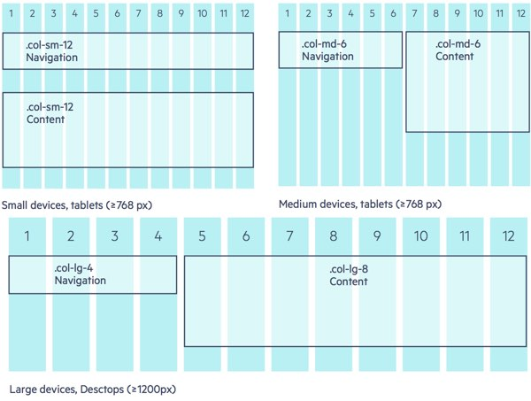
Responsive Web Design
Design

Slide 15
Bootstrap
What is Bootstrap?
Bootstrap is an open source toolkit free front-end framework for faster and easier web development
Bootstrap is the most popular HTML, CSS, and JavaScript framework for developing responsive, mobile-first websites

Slide 16
Bootstrap
Why use Bootstrap?
Easy to use: Anybody with just basic knowledge of HTML and CSS can start using Bootstrap
Responsive feature: Bootstrap's responsive CSS adjusts to phones, tablets, and desktops
Mobile-first approach: In Bootstrap 3, mobile-first styles are part of the core framework
Browser compatibility: Bootstrap is compatible with all modern browsers (Chrome, Firefox, Internet Explorer, Edge, Safari, and Opera)

Slide 17
Bootstrap
How to Bootstrap
Download from https://getbootstrap.com
Include from a CDN

Slide 18
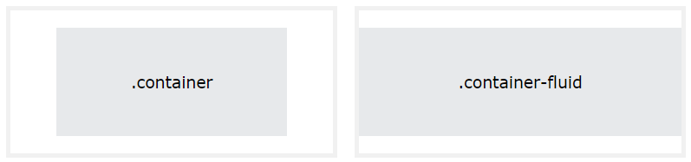
Bootstrap
How to Bootstrap
HTML5 doctype
Viewport Setting
Container Wrapper
.container – fixed with container
.container-fluid – full width container

Slide 19
Bootstrap
How to Bootstrap - v3
<!DOCTYPE html>
<html lang="en">
<head>
<title>Bootstrap v3</title>
<meta charset="utf-8">
<meta name="viewport" content="width=device-width, initial-scale=1">
<link rel="stylesheet" href="https://cdn.jsdelivr.net/npm/bootstrap@3.4.1/dist/css/bootstrap.min.css" integrity="sha384-HSMxcRTRxnN+Bdg0JdbxYKrThecOKuH5zCYotlSAcp1+c8xmyTe9GYg1l9a69psu" crossorigin="anonymous">
<link rel="stylesheet" href="https://cdn.jsdelivr.net/npm/bootstrap@3.4.1/dist/css/bootstrap-theme.min.css" integrity="sha384-6pzBo3FDv/PJ8r2KRkGHifhEocL+1X2rVCTTkUfGk7/0pbek5mMa1upzvWbrUbOZ" crossorigin="anonymous">
<script src="https://code.jquery.com/jquery-1.12.4.min.js" integrity="sha384-nvAa0+6Qg9clwYCGGPpDQLVpLNn0fRaROjHqs13t4Ggj3Ez50XnGQqc/r8MhnRDZ" crossorigin="anonymous"></script>
<script src="https://cdn.jsdelivr.net/npm/bootstrap@3.4.1/dist/js/bootstrap.min.js" integrity="sha384-aJ21OjlMXNL5UyIl/XNwTMqvzeRMZH2w8c5cRVpzpU8Y5bApTppSuUkhZXN0VxHd" crossorigin="anonymous"></script>
</head>
<body>
<div class="container">
<h1>My First Bootstrap Page</h1>
<p>This is some text.</p>
</div>
</body>
</html>
Notes:
Integrity – Subresource Integrity (SRI)

Slide 20
Bootstrap
How to Bootstrap - v4
<!DOCTYPE html>
<html lang="en">
<head>
<title>Bootstrap v4</title>
<meta charset="utf-8">
<meta name="viewport" content="width=device-width, initial-scale=1">
<link rel="stylesheet" href="https://cdn.jsdelivr.net/npm/bootstrap@4.6.2/dist/css/bootstrap.min.css" integrity="sha384-xOolHFLEh07PJGoPkLv1IbcEPTNtaed2xpHsD9ESMhqIYd0nLMwNLD69Npy4HI+N" crossorigin="anonymous">
<script src="https://cdn.jsdelivr.net/npm/jquery@3.5.1/dist/jquery.slim.min.js" integrity="sha384-DfXdz2htPH0lsSSs5nCTpuj/zy4C+OGpamoFVy38MVBnE+IbbVYUew+OrCXaRkfj" crossorigin="anonymous"></script>
<script src="https://cdn.jsdelivr.net/npm/bootstrap@4.6.2/dist/js/bootstrap.bundle.min.js" integrity="sha384-Fy6S3B9q64WdZWQUiU+q4/2Lc9npb8tCaSX9FK7E8HnRr0Jz8D6OP9dO5Vg3Q9ct" crossorigin="anonymous"></script>
</head>
<body>
<div class="container">
<h1>My First Bootstrap Page</h1>
<p>This is some text.</p>
</div>
</body>
</html>

Slide 21
Bootstrap
How to Bootstrap - v5
<!DOCTYPE html>
<html lang="en">
<head>
<title>Bootstrap v5</title>
<meta charset="utf-8">
<meta name="viewport" content="width=device-width, initial-scale=1">
<link href="https://cdn.jsdelivr.net/npm/bootstrap@5.2.3/dist/css/bootstrap.min.css" rel="stylesheet" integrity="sha384-rbsA2VBKQhggwzxH7pPCaAqO46MgnOM80zW1RWuH61DGLwZJEdK2Kadq2F9CUG65" crossorigin="anonymous">
<script src="https://cdn.jsdelivr.net/npm/bootstrap@5.2.3/dist/js/bootstrap.bundle.min.js" integrity="sha384-kenU1KFdBIe4zVF0s0G1M5b4hcpxyD9F7jL+jjXkk+Q2h455rYXK/7HAuoJl+0I4" crossorigin="anonymous"></script>
</head>
<body>
<div class="container">
<h1>My First Bootstrap Page</h1>
<p>This is some text.</p>
</div>
</body>
</html>
Notes:
no need jQuery
not support IE10
using SVG icon

Slide 22
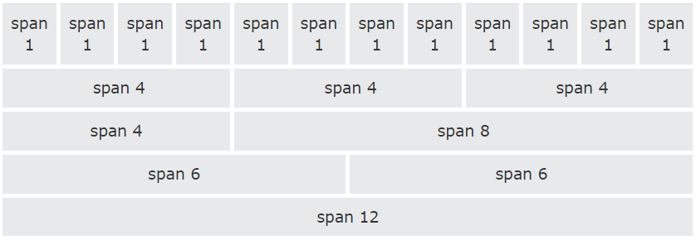
Bootstrap
Grid System
Bootstrap's grid system allows up to 12 columns across the page
Bootstrap's grid system is responsive, and the columns will re-arrange automatically depending on the screen size

Slide 23
Bootstrap
Grid System
Bootstrap grid system has 4 classes
xs - for phones - screens less than 768px wide
sm - for tablets - screens equal to or greater than 768px wide
md - for small laptops - screens equal to or greater than 992px wide
lg - for laptops and desktops - screens equal to or greater than 1200px wide

Slide 24
Bootstrap
Grid System
 | Extra small <768px | Small >=768px | Medium >=992px | Large >=1200px
Class prefix | .col-xs- | .col-sm- | .col-md- | .col-lg-
Suitable for | Phones | Tablets | Small Laptops | Laptops & Desktops
Grid behaviour | Horizontal at all times | Collapsed to start, horizontal above breakpoints | Collapsed to start, horizontal above breakpoints | Collapsed to start, horizontal above breakpoints
Container width | None (auto) | 750px | 970px | 1170px
# of columns | 12 | 12 | 12 | 12
Column width | Auto | ~62px | ~81px | ~97px
Gutter width | 30px (15px on each side of a column) | 30px (15px on each side of a column) | 30px (15px on each side of a column) | 30px (15px on each side of a column)
Nestable | Yes | Yes | Yes | Yes
Offsets | Yes | Yes | Yes | Yes
Column ordering | Yes | Yes | Yes | Yes

Slide 25
Bootstrap
Grid System
<!DOCTYPE html>
<html lang="en">
<head>
<title>Bootstrap</title>
<meta charset="utf-8">
<meta name="viewport" content="width=device-width, initial-scale=1">
<link rel="stylesheet" href="https://cdn.jsdelivr.net/npm/bootstrap@4.6.2/dist/css/bootstrap.min.css">
<script src="https://cdn.jsdelivr.net/npm/jquery@3.5.1/dist/jquery.slim.min.js"></script>
<script src="https://cdn.jsdelivr.net/npm/bootstrap@4.6.2/dist/js/bootstrap.bundle.min.js"></script>
</head>
<body>
<div class="container-fluid">
<h1>Bootstrap Grid</h1>
<div class="row">
<div class="col-xs-6 col-md-3" style="background-color:lightblue;">
Column 1<br>Resize the browser window to see the effect.
</div>
<div class="col-xs-6 col-md-3" style="background-color:linen;">Column 2</div>
<div class="col-xs-6 col-md-6" style="background-color:lightcyan;">
<div class="row h-100">
<div class="col-sm-6 col-md-6" style="background-color:cornsilk;">Column 3/1</div>
<div class="col-sm-6 col-md-6" style="background-color:lavender;">Column 3/2</div>
</div>
</div>
</div>
</div>
</body>
</html>

Slide 26
Bootstrap
Typography
<h1> - <h6> style the HTML heading
<small> - create a lighter, secondary text
<mark> - create a highlight text
<abbr> - mark up an abbreviation or acronym
<blockquote> - use to present content from another source
<code> - inline snippets of code
<kbd> - to indicate input entered
<pre> - multiple code lines of code

Slide 27
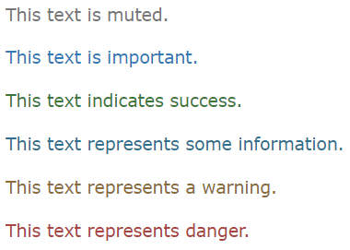
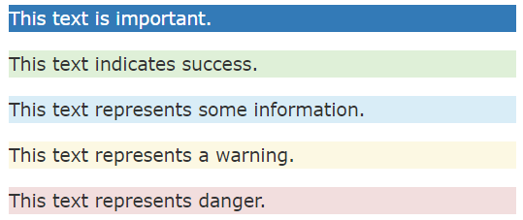
Bootstrap
Typography
Contextual colors and backgrounds
.text-muted, .text-primary, .text-success, .text-info, .text-warning, .text-danger
.bg-primary, .bg-success, .bg-info, .bg-warning, .bg-danger

Slide 28
Bootstrap
Typography
Class | Description
.lead | Makes a paragraph stand out
.small | Indicates smaller text (set to 85% of the size of the parent)
.text-left | Indicates left-aligned text
.text-center | Indicates center-aligned text
.text-right | Indicates right-aligned text
.text-justify | Indicates justified text
.text-nowrap | Indicates no wrap text
.text-lowercase | Indicates lowercased text
.text-uppercase | Indicates uppercased text
.text-capitalize | Indicates capitalized text
.initialism | Displays the text inside an <abbr> element in a slightly smaller font size
.list-unstyled | Removes the default list-style and left margin on list items (works on both <ul> and <ol>). This class only applies to immediate children list items (to remove the default list-style from any nested lists, apply this class to any nested lists as well)
.list-inline | Places all list items on a single line
.dl-horizontal | Lines up the terms (<dt>) and descriptions (<dd>) in <dl> elements side-by-side. Starts off like default <dl>s, but when the browser window expands, it will line up side-by-side
.pre-scrollable | Makes a <pre> element scrollable

Slide 29
Bootstrap
Typography
<!DOCTYPE html>
<html lang="en">
<head>
<title>Bootstrap</title>
<meta charset="utf-8">
<meta name="viewport" content="width=device-width, initial-scale=1">
<link rel="stylesheet" href="https://cdn.jsdelivr.net/npm/bootstrap@4.6.2/dist/css/bootstrap.min.css">
<script src="https://cdn.jsdelivr.net/npm/jquery@3.5.1/dist/jquery.slim.min.js"></script>
<script src="https://cdn.jsdelivr.net/npm/bootstrap@4.6.2/dist/js/bootstrap.bundle.min.js"></script>
</head>
<body>
<div class="container-fluid">
<h1>Bootstrap Typography</h1>
<h1>h1 heading <small>secondary text</small></h1>
<h2>h2 heading <small>secondary text</small></h2>
<h3>h3 heading <small>secondary text</small></h3>
<h4>h4 heading <small>secondary text</small></h4>
<h5>h5 heading <small>secondary text</small></h5>
<h6>h6 heading <small>secondary text</small></h6>
<blockquote class="blockquote">
<p class="mb-0">The blockquote element is used to present content from another source</p>
<footer class="blockquote-footer">Some footer</footer>
</blockquote>
<p>Use &lt;code&gt; tag <code>span</code>,<code>section</code>,<code>div</code> defines in document.</p>
<p>Use the <mark>&lt;mark&gt;</mark> tag to highlight text.</p>
<p>Use tag &lt;<abbr title="Abbreviation">abbr</abbr>&gt; mark up an abbreviation.</p>
<p>Use <kbd>ctrl + p</kbd> to open the Print dialog box.</p>
</div>
</body>
</html>

Slide 30
Bootstrap
Form Input
Add class .form-control to all textual element
Add class .from-group if you want to wrap up label and from control
Add class .input-group if you want to enhance input by adding icon, text or button
Input sizing
Bootstrap v3 | Bootstrap v4 | Description
.input-sm | .form-control-sm | For small input
.input-lg | .form-control-lg | For large input

Slide 31
Bootstrap
Form Input
<!DOCTYPE html>
<html lang="en">
<head>
<title>Bootstrap v4</title>
<meta charset="utf-8">
<meta name="viewport" content="width=device-width, initial-scale=1">
<link rel="stylesheet" href="https://cdn.jsdelivr.net/npm/bootstrap@4.6.2/dist/css/bootstrap.min.css">
<script src="https://cdn.jsdelivr.net/npm/jquery@3.5.1/dist/jquery.slim.min.js"></script>
<script src="https://cdn.jsdelivr.net/npm/bootstrap@4.6.2/dist/js/bootstrap.bundle.min.js"></script>
</head>
<body>
<div class="container">
<h1>Form Control</h1>
<form>
<div class="form-group">
<label for="usr">Name</label>
<input type="text" class="form-control" id="usr">
</div>
<div class="form-group">
<label for="pwd">Password</label>
<input type="password" class="form-control" id="pwd">
</div>
</form>
</div>
</body>
</html>

Slide 32
Bootstrap
Form Input – Input Sizing
<!DOCTYPE html>
<html>
<head>
<title>Bootstramp v4</title>
<meta charset="UTF-8">
<meta name="viewport" content="width=device-width, initial-scale=1">
<link rel="stylesheet" href="https://cdn.jsdelivr.net/npm/bootstrap@4.6.2/dist/css/bootstrap.min.css">
<script src="https://cdn.jsdelivr.net/npm/jquery@3.5.1/dist/jquery.slim.min.js"></script>
<script src="https://cdn.jsdelivr.net/npm/bootstrap@4.6.2/dist/js/bootstrap.bundle.min.js"></script>
</head>
<body>
<div class="container">
<form> <br>
<div class="form-group">
<label class="control-label">Small</label>
<input type="text" class="form-control form-control-sm"/>
</div>
<div class="form-group">
<label class="control-label">Normal</label>
<input type="text" class="form-control"/>
</div>
<div class="form-group">
<label class="control-label">Large</label>
<input type="text" class="form-control form-control-lg"/>
</div>
</form>
</div>
</body>
</html>

Slide 33
Bootstrap
Form Input – Input Group
<!DOCTYPE html>
<html>
<head>
<title>Bootstramp v4</title>
<meta charset="UTF-8">
<meta name="viewport" content="width=device-width, initial-scale=1">
<link rel="stylesheet" href="https://cdn.jsdelivr.net/npm/bootstrap@4.6.2/dist/css/bootstrap.min.css">
<script src="https://cdn.jsdelivr.net/npm/jquery@3.5.1/dist/jquery.slim.min.js"></script>
<script src="https://cdn.jsdelivr.net/npm/bootstrap@4.6.2/dist/js/bootstrap.bundle.min.js"></script>
</head>
<body>
<div class="container">
<form> <br>
<div class="input-group input-group-sm">
<div class="input-group-prepend"><span class="input-group-text">Small</span></div>
<input type="text" class="form-control"/>
</div> <br>
<div class="input-group">
<div class="input-group-prepend"><span class="input-group-text">Normal</span></div>
<input type="text" class="form-control"/>
</div> <br>
<div class="input-group input-group-lg">
<input type="text" class="form-control"/>
<div class="input-group-append"><span class="input-group-text">Large</span></div>
</div>
</form>
</div>
</body>
</html>

Slide 34
Bootstrap
Button
Classes : .btn, .btn-primary, .btn-secondary, .btn-success, .btn-info, .btn-warning, .btn-danger, .btn-dark, .btn-light, .btn-link
Outline : .btn-outline-primary, .btn-outline-secondary, .btn-outline-success, .btn-outline-info, .btn-outline-warning, .btn-outline-danger, .btn-outline-dark, .btn-outline-light
Sizes : .btn-sm, .btn-lg
Active/Disabled : .active, .disabled
Notes:
.btn-default has gone in v4

Slide 35
Bootstrap
Button
<!DOCTYPE html>
<html>
<head>
<title>Bootstramp v4</title>
<meta charset="UTF-8">
<meta name="viewport" content="width=device-width, initial-scale=1">
<link rel="stylesheet" href="https://cdn.jsdelivr.net/npm/bootstrap@4.6.2/dist/css/bootstrap.min.css">
<script src="https://cdn.jsdelivr.net/npm/jquery@3.5.1/dist/jquery.slim.min.js"></script>
<script src="https://cdn.jsdelivr.net/npm/bootstrap@4.6.2/dist/js/bootstrap.bundle.min.js"></script>
</head>
<body>
<div class="container">
<button type="button" class="btn">Basic</button>
<button type="button" class="btn btn-primary">Primary</button>
<button type="button" class="btn btn-secondary">Secondary</button>
<button type="button" class="btn btn-success">Success</button>
<button type="button" class="btn btn-info">Info</button>
<button type="button" class="btn btn-warning">Warning</button>
<button type="button" class="btn btn-danger">Danger</button>
<button type="button" class="btn btn-dark">Dark</button>
<button type="button" class="btn btn-light">Light</button>
<button type="button" class="btn btn-link">Link</button>
<br><br>
<button type="button" class="btn btn-primary btn-lg">Large</button>
<button type="button" class="btn btn-primary">Normal</button>
<button type="button" class="btn btn-primary btn-sm">Small</button>
<br><br>
<button type="button" class="btn btn-primary active">Active Primary</button>
<button type="button" class="btn btn-primary disabled">Disabled Primary</button>
</div>
</body>
</html>

Slide 36
Bootstrap
Icon
Bootstrap 3
provides glyphicons as part of its own icon library
Bootstrap 4
not support glypicons but you can using awesome font

Slide 37
Bootstrap
Icon
<!DOCTYPE html>
<html>
<head>
<title>Bootstramp v4</title>
<meta charset="UTF-8">
<meta name="viewport" content="width=device-width, initial-scale=1">
<link rel="stylesheet" href="https://use.fontawesome.com/releases/v5.6.3/css/all.css" integrity="sha384-UHRtZLI+pbxtHCWp1t77Bi1L4ZtiqrqD80Kn4Z8NTSRyMA2Fd33n5dQ8lWUE00s/" crossorigin="anonymous">
<link rel="stylesheet" href="https://cdn.jsdelivr.net/npm/bootstrap@4.6.2/dist/css/bootstrap.min.css">
<script src="https://cdn.jsdelivr.net/npm/jquery@3.5.1/dist/jquery.slim.min.js"></script>
<script src="https://cdn.jsdelivr.net/npm/bootstrap@4.6.2/dist/js/bootstrap.bundle.min.js"></script>
</head>
<body>
<div class="container">
<em class="fas fa-heart"></em>
<em class="fas fa-thumbs-up"></em>
<em class="fas fa-cloud"></em>
<em class="fas fa-search"></em>
<em class="fas fa-cog"></em>
<em class="fas fa-file"></em>
<em class="fas fa-edit"></em>
<em class="fas fa-trash"></em>
</div>
</body>
</html>

Slide 38
Bootstrap
Badges
Badges are numerical indicators of how many items are associated with
Add class .badge within element
Contextual Badges
.badge-primary, .badge-secondary, .badge-success, .badge-danger, .badge-warning, .badge-info, .badge-light, .badge-dark
Pill Badges
.badge-pill

Slide 39
Bootstrap
Badges - Contextual
<!DOCTYPE html>
<html>
<head>
<title>Bootstramp v4</title>
<meta charset="UTF-8">
<meta name="viewport" content="width=device-width, initial-scale=1">
<link rel="stylesheet" href="https://cdn.jsdelivr.net/npm/bootstrap@4.6.2/dist/css/bootstrap.min.css">
<script src="https://cdn.jsdelivr.net/npm/jquery@3.5.1/dist/jquery.slim.min.js"></script>
<script src="https://cdn.jsdelivr.net/npm/bootstrap@4.6.2/dist/js/bootstrap.bundle.min.js"></script>
</head>
<body>
<div class="container">
<span class="badge badge-primary">Primary</span>
<span class="badge badge-secondary">Secondary</span>
<span class="badge badge-success">Success</span>
<span class="badge badge-danger">Danger</span>
<span class="badge badge-warning">Warning</span>
<span class="badge badge-info">Info</span>
<span class="badge badge-light">Light</span>
<span class="badge badge-dark">Dark</span>
<button type="button" class="btn btn-primary">
Messages <span class="badge badge-light">4</span>
</button>
</div>
</body>
</html>

Slide 40
Bootstrap
Badges - Pill
<!DOCTYPE html>
<html>
<head>
<title>Bootstramp v4</title>
<meta charset="UTF-8">
<meta name="viewport" content="width=device-width, initial-scale=1">
<link rel="stylesheet" href="https://cdn.jsdelivr.net/npm/bootstrap@4.6.2/dist/css/bootstrap.min.css">
<script src="https://cdn.jsdelivr.net/npm/jquery@3.5.1/dist/jquery.slim.min.js"></script>
<script src="https://cdn.jsdelivr.net/npm/bootstrap@4.6.2/dist/js/bootstrap.bundle.min.js"></script>
</head>
<body>
<div class="container">
<span class="badge badge-pill badge-primary">Primary</span>
<span class="badge badge-pill badge-secondary">Secondary</span>
<span class="badge badge-pill badge-success">Success</span>
<span class="badge badge-pill badge-danger">Danger</span>
<span class="badge badge-pill badge-warning">Warning</span>
<span class="badge badge-pill badge-info">Info</span>
<span class="badge badge-pill badge-light">Light</span>
<span class="badge badge-pill badge-dark">Dark</span>
<button type="button" class="btn btn-primary">
Messages <span class="badge badge-pill badge-light">4</span>
</button>
</div>
</body>
</html>

Slide 41
Bootstrap
Dropdown
Dropdown menu is a toggleable menu that allows user to choose one value from a predefined list
Add class .dropdown indicate a dropdown menu
Add class .dropdown-toggle and data-toggle=“dropdown” attribute to open dropdown menu within button or link
Add class .caret to create a caret arrow icon
Add class .dropdown-menu to main menu
Add class .dropdown-item to each menu item
Add class .divider to separate link inside dropdown menu

Slide 42
Bootstrap
Dropdown
<!DOCTYPE html>
<html>
<head>
<title>Bootstramp v4</title>
<meta charset="UTF-8">
<meta name="viewport" content="width=device-width, initial-scale=1">
<link rel="stylesheet" href="https://cdn.jsdelivr.net/npm/bootstrap@4.6.2/dist/css/bootstrap.min.css">
<script src="https://cdn.jsdelivr.net/npm/jquery@3.5.1/dist/jquery.slim.min.js"></script>
<script src="https://cdn.jsdelivr.net/npm/bootstrap@4.6.2/dist/js/bootstrap.bundle.min.js"></script>
</head>
<body>
<div class="container-fluid">
<div class="dropdown">
<a href="#" class="btn btn-primary dropdown-toggle" data-toggle="dropdown">My Name <span class="caret"></span></a>
<div class="dropdown-menu">
<a href="#" class="dropdown-item">Profile</a>
<a href="#" class="dropdown-item">Change Password</a>
<div class="dropdown-divider"></div>
<a href="#" class="dropdown-item">Log Out</a>
</div>
</div>
</div>
</body>
</html>

Slide 43
Bootstrap
Navbar
A navigation bar is a navigation header that is placed at the top of the page
Add class .navbar and .navbar-expand-xl|lg|md|sm collapsing class
Add class=“navbar-nav” to element group ex. <ul>
Add class .nav-item to item element ex. <li>
Add class .nav-link for <a>

Slide 44
Bootstrap
Navbar
<nav id="navigatebar" class="navbar navbar-expand-sm bg-secondary navbar-dark">
<a class="navbar-brand" href="#">My Bootstrap</a>
<ul class="nav navbar-nav ">
<li class="nav-item dropdown">
<a href="#" class="nav-link dropdown-toggle" data-toggle="dropdown">Home</a>
<div class="dropdown-menu">
<a href="#" class="dropdown-item">Page 1</a>
<a href="#" class="dropdown-item">Page 2</a>
<a href="#" class="dropdown-item">Page 3</a>
</div>
</li>
</ul>
<ul class="nav navbar-nav ml-auto">
<li class="dropdown nav-item">
<a href="#" class="nav-link dropdown-toggle" data-toggle="dropdown">My Name</a>
<div class="dropdown-menu dropdown-menu-right">
<a href="#" class="dropdown-item">Profile</a>
<a href="#" class="dropdown-item">Change Password</a>
<div class="dropdown-divider"></div>
<a href="#" class="dropdown-item">Log Out</a>
</div>
</li>
</ul>
</nav>

Slide 45
Bootstrap
Table
A basic table has a light padding and horizontal dividers
Add class .table to <table>
Add class .table-striped for striped rows
Add class .table-bordered to add borders on all sides of the table and cells
Add class .table-hover for a hover effect on table rows
Add class .table-borderless to remove borders from the table
Add class .thead-dark, .thead-light for a black ground color to table header

Slide 46
Bootstrap
Table
Contextual classes
Class | Description
.table-primary | Blue: Indicates an important action
.table-success | Green: Indicates a successful or positive action
.table-danger | Red: Indicates a dangerous or potentially negative action
.table-info | Light blue: Indicates a neutral informative change or action
.table-warning | Orange: Indicates a warning that might need attention
.table-active | Grey: Applies the hover color to the table row or table cell
.table-secondary | Grey: Indicates a slightly less important action
.table-light | Light grey table or table row background
.table-dark | Dark grey table or table row background

Slide 47
Bootstrap
Table
Responsive table
<div class="table-responsive"> <table class="table"> ... </table> </div>
Class | Screen width
.table-responsive-sm | < 576px
.table-responsive-md | < 768px
.table-responsive-lg | < 992px
.table-responsive-xl | < 1200px

Slide 48
Bootstrap
Table
<!DOCTYPE html>
<html>
<head>
<title>Bootstramp v4</title>
<meta charset="UTF-8">
<meta name="viewport" content="width=device-width, initial-scale=1">
<link rel="stylesheet" href="https://cdn.jsdelivr.net/npm/bootstrap@4.6.2/dist/css/bootstrap.min.css">
<script src="https://cdn.jsdelivr.net/npm/jquery@3.5.1/dist/jquery.slim.min.js"></script>
<script src="https://cdn.jsdelivr.net/npm/bootstrap@4.6.2/dist/js/bootstrap.bundle.min.js"></script>
</head>
<body>
<div class="container">
<div class="table-responsive">
<table id="datatable" class="table table-bordered table-hover table-striped">
<thead class="thead-light">
<tr><th>Share</th><th>Unit</th><th>Price</th><th>Amount</th></tr>
</thead>
<tbody>
<tr><td>BBL</td><td>500</td><td>25</td><td>12500</td></tr>
<tr><td>SCB</td><td>400</td><td>50</td><td>20000</td></tr>
<tr><td>TMB</td><td>1200</td><td>15</td><td>18000</td></tr>
<tr><td>KBANK</td><td>750</td><td>55</td><td>41250</td></tr>
<tr><td>CIMB</td><td>350</td><td>40</td><td>14000</td></tr>
<tr><td>SCNB</td><td>1000</td><td>30</td><td>30000</td></tr>
</tbody>
</table>
</div>
</div>
</body>
</html>

Slide 49
Bootstrap
Modal
Modal component is a dialog box/popup window that is displayed on top of the current page
Modal part
1st layer
Add class .modal to <div> with an ID for trigger
Can add class animation for effect ex. .fade
2nd layer
Add class .modal-dialog setting proper width & margin
Content part
Add class .modal-content consist of 3 layer
.modal-header
.modal-body
.modal-footer
Trigger part
Add attribute data-toggle=“modal”
Add attribute data-target=“#ID” point to an ID of 1st layer in modal part

Slide 50
Bootstrap
Modal
Modal Size
.modal-sm – small modal
.modal-lg – large modal
.modal-xl – extra large modal
Modal dismiss
Add attribute data-dismiss=“modal”

Slide 51
Bootstrap
Modal
<!DOCTYPE html>
<html>
<head>
<title>Bootstramp v4</title>
<meta charset="UTF-8">
<meta name="viewport" content="width=device-width, initial-scale=1">
<link rel="stylesheet" href="https://cdn.jsdelivr.net/npm/bootstrap@4.6.2/dist/css/bootstrap.min.css">
<script src="https://cdn.jsdelivr.net/npm/jquery@3.5.1/dist/jquery.slim.min.js"></script>
<script src="https://cdn.jsdelivr.net/npm/bootstrap@4.6.2/dist/js/bootstrap.bundle.min.js"></script>
</head>
<body>
<div class="container">
<button class="btn btn-dark btn-sm" id="button1" data-toggle="modal" data-target="#modaldialog1">Show Modal</button>
<div id="modaldialog1" class="modal fade" role="dialog">
<div class="modal-dialog">
<div class="modal-content">
<div class="modal-header">
<h4 class="modal-title">Dialog</h4>
<button type="button" class="close" data-dismiss="modal">&times;</button>
</div>
<div class="modal-body"> <p>Bootstrap Dialog 1</p> </div>
<div class="modal-footer">
<button type="button" class="btn btn-dark btn-sm" data-dismiss="modal">Cancel</button>
</div>
</div>
</div>
</div>
</div>
</body>
</html>

Slide 52
Bootstrap
Utilities
Border - .border
.border-0, .border-top-0, .border-right-0, .border-bottom-0, .border-left-0
Border Color
.border-primary, .border-secondary, .border-success, .border-danger, .border-warning, .border-info, .border-dark, .border-light, .border-white
Border Radius
.rounded, .rounded-sm, .rounded-lg, .rounded-top, .rounded-right, .rounded-bottom, .rounded-left, .rounded-circle, .rounded-0

Slide 53
Bootstrap
Utilities
Float & Clearfix
.float-right – float an element to the right
.float-left – float an element to the left
.clearfix – to clear float
Responsive Float
.float-*-left|right
sm – small (>=576px)
md – medium (>=768px)
lg – large (>=992px)
xl – extra large (>=1200px)
Center Align
.mx-auto – add margin-left & margin-right: auto
Width
w-* - .w-25, .w-50, .w-75, .w-100, .mx-100
Height
h-* - .h-25, .h-50, .h-75, .h-100, .mh-100

Slide 54
Bootstrap
Utilities
Spacing - classes are used in the format: {property}{sides}-{size}
property
m – sets margin
p – sets padding
sides
t - sets margin-top or padding-top
b - sets margin-bottom or padding-bottom
l - sets margin-left or padding-left
r - sets margin-right or padding-right
x - sets both padding-left and padding-right or margin-left and margin-right
y - sets both padding-top and padding-bottom or margin-top and margin-bottom
blank - sets a margin or padding on all 4 sides of the element

Slide 55
Bootstrap
Utilities
Spacing
size
0 - sets margin or padding to 0
1 - sets margin or padding to .25rem (4px if font-size is 16px)
2 - sets margin or padding to .5rem (8px if font-size is 16px)
3 - sets margin or padding to 1rem (16px if font-size is 16px)
4 - sets margin or padding to 1.5rem (24px if font-size is 16px)
5 - sets margin or padding to 3rem (48px if font-size is 16px)
auto - sets margin to auto
margins can also be negative, by adding an "n" in front of size
n1 - sets margin to -.25rem (-4px if font-size is 16px)
n2 - sets margin to -.5rem (-8px if font-size is 16px)
n3 - sets margin to -1rem (-16px if font-size is 16px)
n4 - sets margin to -1.5rem (-24px if font-size is 16px)
n5 - sets margin to -3rem (-48px if font-size is 16px)

Slide 56
Bootstrap
Utilities
Spacing
.m-# / m-*-# | margin on all sides
.mt-# / mt-*-# | margin top
.mb-# / mb-*-# | margin bottom
.ml-# / ml-*-# | margin left
.mr-# / mr-*-# | margin right
.mx-# / mx-*-# | margin left and right
.my-# / my-*-# | margin top and bottom
.p-# / p-*-# | padding on all sides
.pt-# / pt-*-# | padding top
.pb-# / pb-*-# | padding bottom
.pl-# / pl-*-# | padding left
.pr-# / pr-*-# | padding right
.py-# / py-*-# | padding top and bottom
.px-# / px-*-# | padding left and right

Slide 57
Bootstrap
Utilities
Shadow
.shadow, .shadow-none, .shadow-sm, .shadow-lg
Align
.align-baseline, .align-top, .align-middle, .align-bottom, .align-text-top, .align-text-bottom
Visibility
.visible, .invisible
Position
.fixed-top, .fixed-bottom, .sticky-top
Color
.text-muted, .text-primary, .text-secondary, .text-success, .text-info, .text-warning, .text-danger, .text-dark, .text-light, .text-white, .text-body
Background Color
.bg-primary, .bg-secondary, .bg-success, .bg-info, .bg-warning, .bg-danger, .bg-dark, .bg-light

Slide 58
Bootstrap
Utilities
Typography
Class | Description
.display-* | Display headings are used to stand out more than normal headings (larger font-size and lighter font-weight), and there are four classes to choose from: .display-1, .display-2, .display-3, .display-4
.font-weight-bold | Bold text
.font-weight-bolder | Bolder bold text
.font-weight-normal | Normal text
.font-weight-light | Light weight text
.font-weight-lighter | Lighter weight text
.font-italic | Italic text
.lead | Makes a paragraph stand out
.small | Indicates smaller text (set to 85% of the size of the parent)
.text-break | Prevents long text from breaking layout
.text-center | Indicates center-aligned text
.text-decoration-none | Removes the underline from a link
.text-left | Indicates left-aligned text
.text-justify | Indicates justified text
.text-monospace | Monospaced text

Slide 59
Bootstrap
Utilities
Typography
Class | Description
.text-nowrap | Indicates no wrap text
.text-lowercase | Indicates lowercased text
.text-reset | Resets the color of a text or a link (inherits the color from its parent)
.text-right | Indicates right-aligned text
.text-uppercase | Indicates uppercased text
.text-capitalize | Indicates capitalized text
.initialism | Displays the text inside an <abbr> element in a slightly smaller font size
.list-unstyled | Removes the default list-style and left margin on list items (works on both <ul> and <ol>). This class only applies to immediate children list items (to remove the default list-style from any nested lists, apply this class to any nested lists as well)
.list-inline | Places all list items on a single line (used together with .list-inline-item on each <li> elements)
.pre-scrollable | Makes a <pre> element scrollable

Slide 60
Bootstrap
Utilities
Other Display Classes
Class | Description
.d-none | Hides an element
.d-*-none | Hides an element on a specific screen size
.d-inline | Makes an element inline
.d-*-inline | Makes an element inline on a specific screen size
.d-inline-block | Makes an element inline block
.d-*-inline-block | Makes an element inline block on a specific screen size
.d-table | Makes an element display as a table
.d-*-table | Makes an element display as a table on a specific screen size
.d-table-cell | Makes an element display as a table cell
.d-*-table-cell | Makes an element display as a table cell on a specific screen size
.d-table-row | Makes an element display as a table row
.d-*-table-row | Makes an element display as a table row on a specific screen size
.d-flex | Creates a flexbox container and transforms direct children into flex items
.d-*-flex | Creates a flexbox container on a specific screen size
.d-inline-flex | Creates an inline flexbox container
.d-*-inline-flex | Creates an inline flexbox container on a specific screen size

Slide 61
Reference
https://www.w3schools.com/bootstrap/default.asp
https://www.w3schools.com/bootstrap4/default.asp
https://getbootstrap.com/docs/versions/
https://www.tutorialspoint.com/bootstrap/index.htm
https://www.tutorialrepublic.com/twitter-bootstrap-tutorial/

Slide 62
Q & A

